Slide 1
Welcome!
MHAC Advisory Council
James Fuccione – Senior Director
April 2019
The work of the Massachusetts Healthy Aging Collaborative is supported in part by:

Slide 2
Today’s Agenda
MHAC – Progress Report
Honoring Choices MA, Healthcare Decisions Month
Metropolitan Area Planning Council – MetroCommon
Age- and Dementia Friendly Community Update
Dementia Friends
Advisory Council Networking

Slide 3
MHAC Strategy
The Massachusetts Healthy Aging Collaborative is a network of leaders in community, health and wellness, government, advocacy, research, business, education, and philanthropy who have come together to advance healthy aging.
Building the Age-Friendly Movement
Embed Access, Equity and Inclusion within the movement
Develop/Promote Policy and Advocacy Platform for Healthy Aging
Deepen Capacity-Building for Communities

Slide 4
Age- and Dementia Friendly Communities
A continuous improvement and collective impact process for communities
Transportation
Communication & Information
Housing
Age + Dementia Friendly
Outdoor Spaces & Buildings
Social Inclusion & Participation
Services (Community, Health, Business)
Public Safety
Civic Participation & Employment

Slide 5
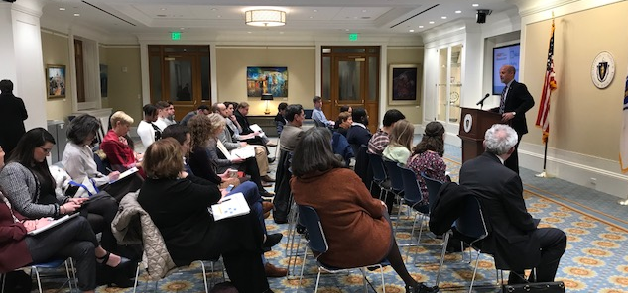
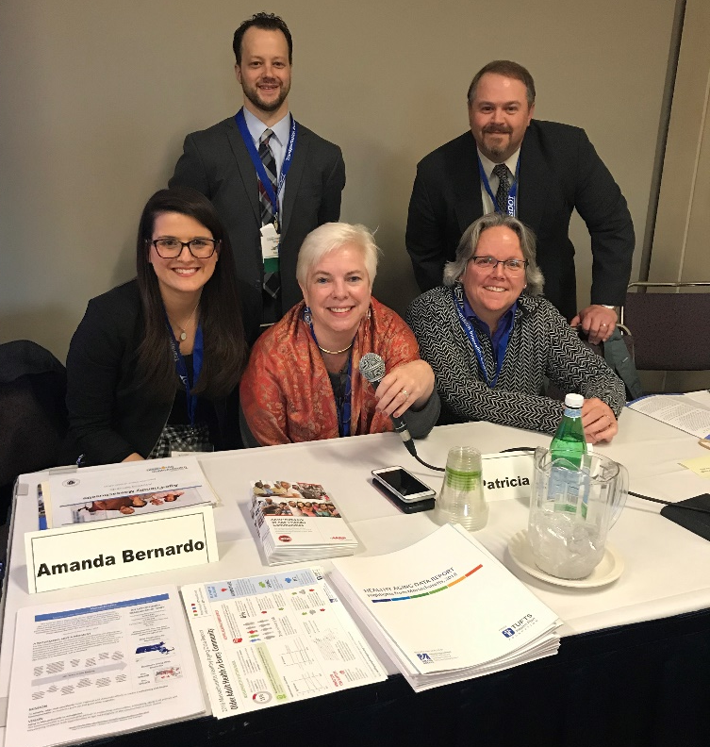
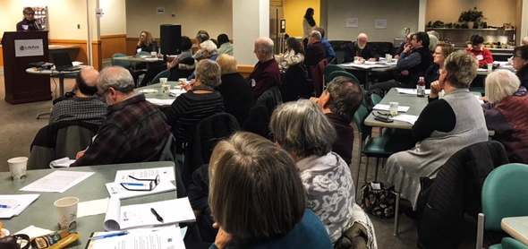
Making the Rounds

Slide 6
Inclusive Communities

Slide 7
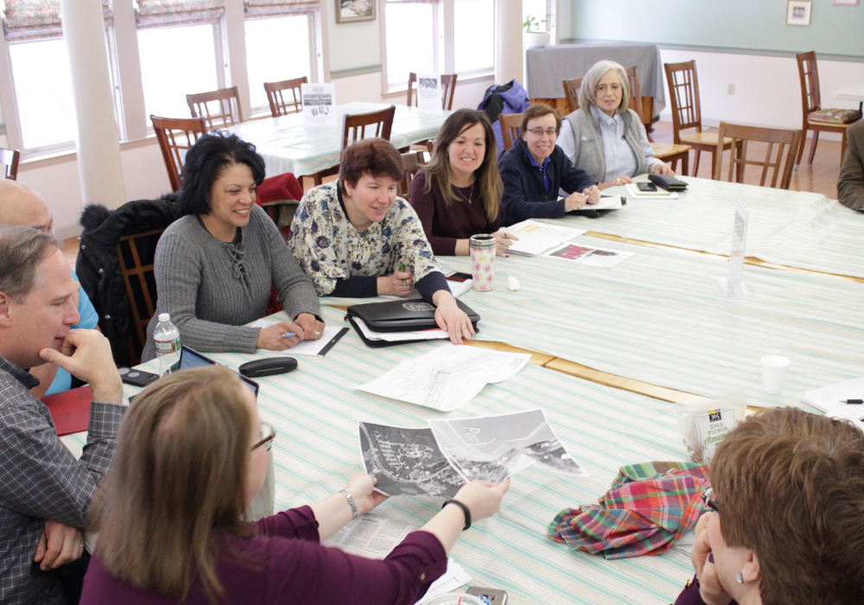
Recent News: ICYMI
NATIONAL PLANNING ACHIEVEMENT AWARD FOR A GRASSROOTS INITIATIVE — GOLD
Operating without a budget and no true authority in the municipality, STAC has created a culture where people of all demographics can be involved in the planning process.
The group's success includes but is not limited to:
expanding public transit service,
improving vehicle parking signage,
introducing maps for bicycle parking locations, and supporting Complete Streets initiatives
all while creating a transparent, safe place for people to participate and work together on finding solutions for all rather than the few.
AF + DF

Slide 8
New Active Communities
AF + DF

Slide 9
One Week Warning
AF + DF

Slide 10
Today’s Agenda
MHAC – Progress Report
Honoring Choices MA, Healthcare Decisions Month
Metropolitan Area Planning Council – MetroCommon
Age- and Dementia Friendly Community Update
Dementia Friends
Advisory Council Networking

Slide 11
Today’s Agenda
MHAC – Progress Report
Honoring Choices MA, Healthcare Decisions Month
Metropolitan Area Planning Council – MetroCommon
Age- and Dementia Friendly Community Update
Dementia Friends
Advisory Council Networking

Slide 12
Thank You!
James Fuccione: James.Fuccione@mahealthyaging.org
617-717-9493

