Slide 1



MHAC Advisory Council
James Fuccione – MHAC Senior Director
Fitchburg State University – October 22, 2019
The work of the Massachusetts Healthy Aging Collaborative is supported in part by:

Slide 2
MHAC Strategy
The Massachusetts Healthy Aging Collaborative is a network of leaders in community, health and wellness, government, advocacy, research, business, education, and philanthropy who have come together to advance healthy aging.
Building the Age-Friendly Movement
Embed Access, Equity and Inclusion within the movement
Develop/Promote Policy and Advocacy Platform for Healthy Aging
Deepen Capacity-Building for Communities

Slide 3


Defining Age-Friendly
Age-friendly environments foster health and well-being and the participation of people as they age. They are accessible, equitable, inclusive, safe and secure, and supportive.
Without age-friendly environments, health for all cannot be achieved.
Creating barrier-free and affordable housing, accessible public spaces, and transportation enable people to stay independent and participate in community life.
Older people play a crucial role in their communities – they engage in paid or volunteering work, transmit experience and knowledge, and help their families with caring responsibilities.
…These contributions can only be ensured if societies foster their health and participation.

Slide 4


Defining Age-Friendly

Slide 5

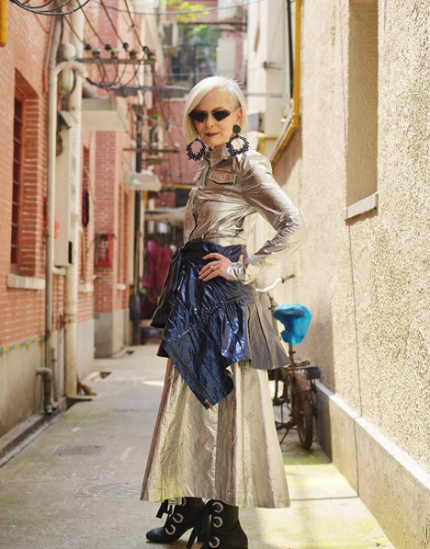
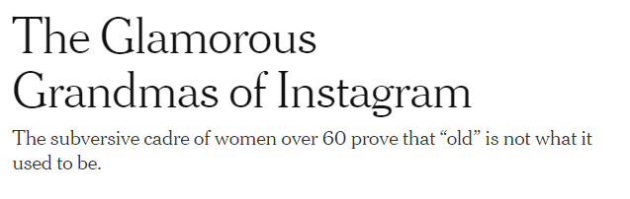


Insta-grans
June 20, 2018
Married or single, working or not, and most often grandmothers, they are asserting their presence on Instagram, intent, in the process, on subverting shopworn notions of what “old” looks and feels like. They are, to hear some tell it, “100 percent slaying.”
https://www.nytimes.com/2018/06/20/style/instagram-grandmas.html

Slide 6
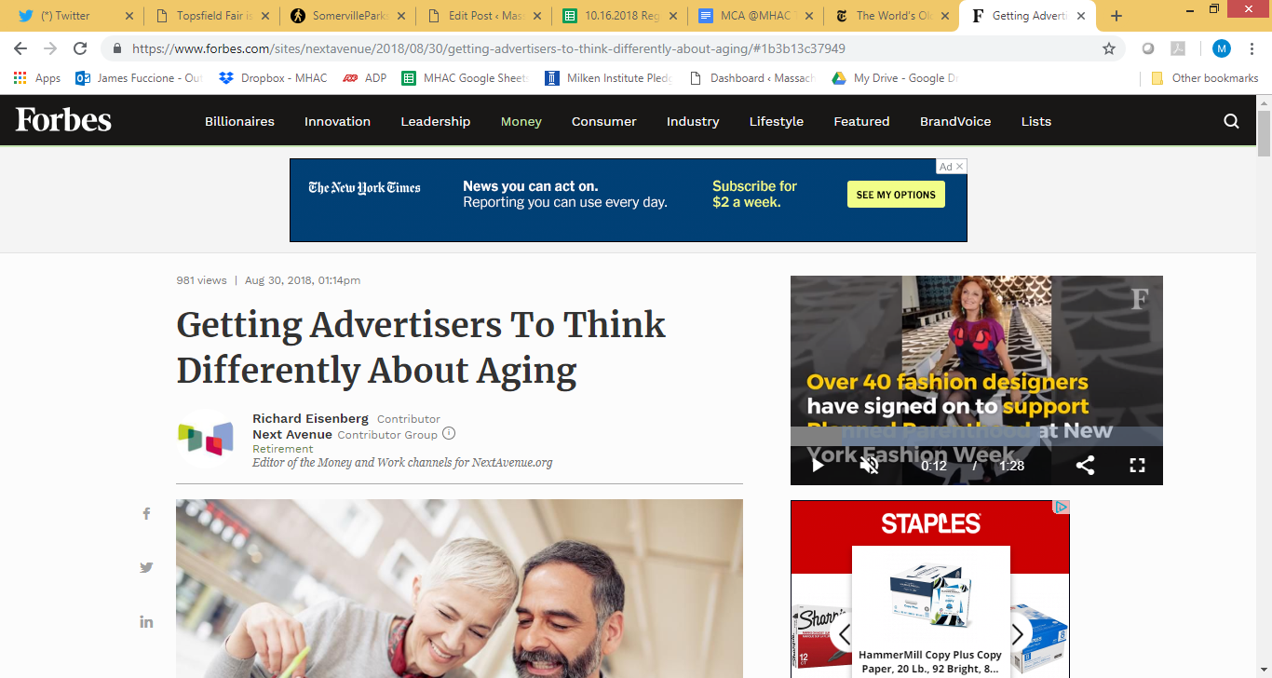
Marketing, Advertising, and Healthy Aging
8/30/18
Truth About Aging Report:
Survey of 24,000 people in 28 markets around the world
Age is becoming a less reliable indicator of just about anything. You can’t reliably say that at X age you have ‘this’ style or health or ambition or success or aspirations or relationships or family structure. There are style icons in their 90s; you have billionaires who are 25. People are dating in nursing homes.
We’re not saying that demographic measures like age are not important; they certainly are. But they’re not the most important thing and they’re becoming less reliable.
If you boiled down the findings to a five-second headline, it would be: Aging Isn’t Just for the Old and Living Isn’t Just for the Young.

Slide 7
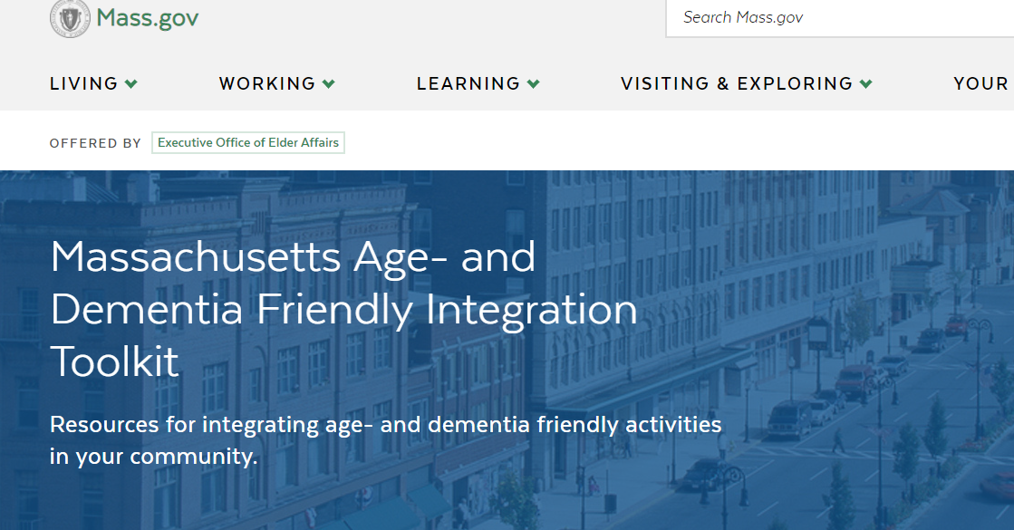
Age- and Dementia Friendly Communities

Slide 8












Age- and Dementia Friendly Communities
Continuous improvement and collective impact process for communities
Transportation
Communication & Information
Housing
Age + Dementia Friendly
Outdoor Spaces & Buildings
Access, Equity, Inclusion
Services (Community, Health, Business)
Social Inclusion & Participation
Public Safety
Civic Participation & Employment

Slide 9
Collaborative, Open-Door Approach
It all starts with CONVENING: Active Age- and Dementia Friendly models in Massachusetts
Age- and Dementia Friendly Cape Ann (SeniorCare, Inc. – Leader/Coordinator):
  ASAP-led model with support from Tufts Health Plan Foundation to work with UMass-Boston for four communities (Gloucester, Rockport, Essex, Manchester)
Age-Friendly Berkshires (Berkshire Elder Services – participant):
  Countywide effort began with regional planning agency and private-pay home care company that lead “planning” and “people” sides of the work, respectively.
Age-Friendly Boston (Leader/Coordinator):
  City’s Elderly Commission on Affairs of the Elderly (now Age Strong Commission) have dedicated staff to convene groups, liaise between city departments and carry out action plan.
MAPC/MAGIC Sub-Region (Minuteman Senior Services – supporter):
  Planning sub-region coordinates and leads an approach focused on housing and transportation, but also supports individual town efforts.
Salem for All Ages (North Shore Elder Services – Leadership Council):
  Volunteer, retired professor leads “people” side of the work with support from Mayor’s office and local volunteers/volunteer orgs

Slide 10
Partnership Opportunities: Municipal Gov’t
Accounting
Animal Control
Assessing Department & Board of Assessors
Board of Selectmen
Capital Projects & Facilities Management
Conservation Commission
Community & Economic Development
Council on Aging
Cultural Council
Finance Division
Fire
Health Department
Human Resources
Human Services
Inspectional Services
Library
Licensing
Parks, Recreation
Planning Board
Police
Public Schools
Public Works
Purchasing
Retirement Board
Technology Services
Town Clerk
Town Manager
Treasurer / Collector
Veterans Services
Zoning Board of Appeals
Aging in all Policies

Slide 11
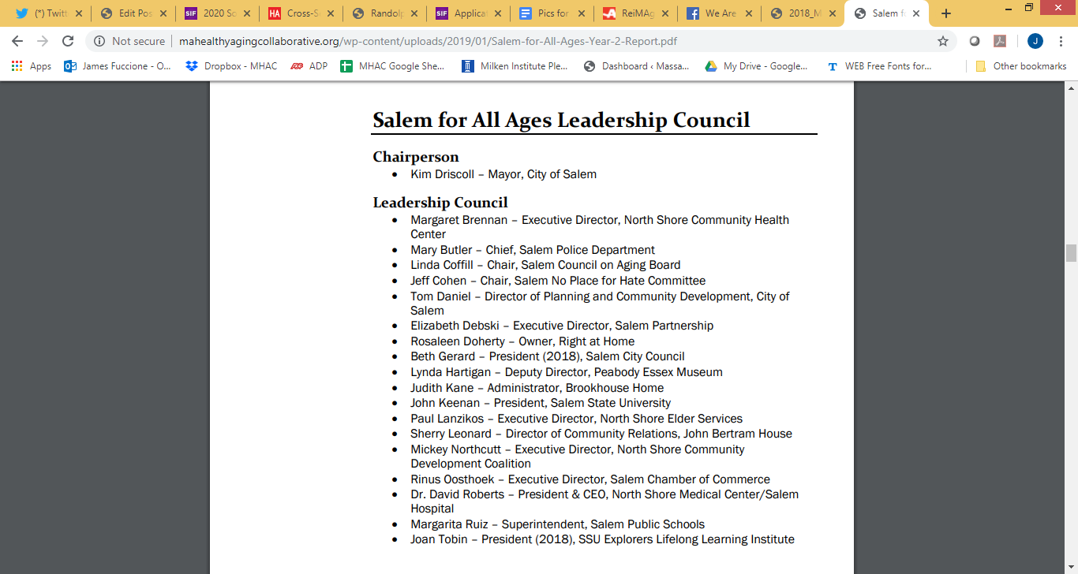
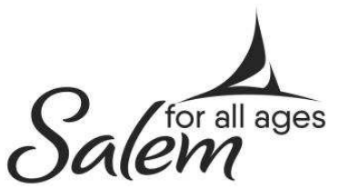
Stakeholders and Partners

Slide 12
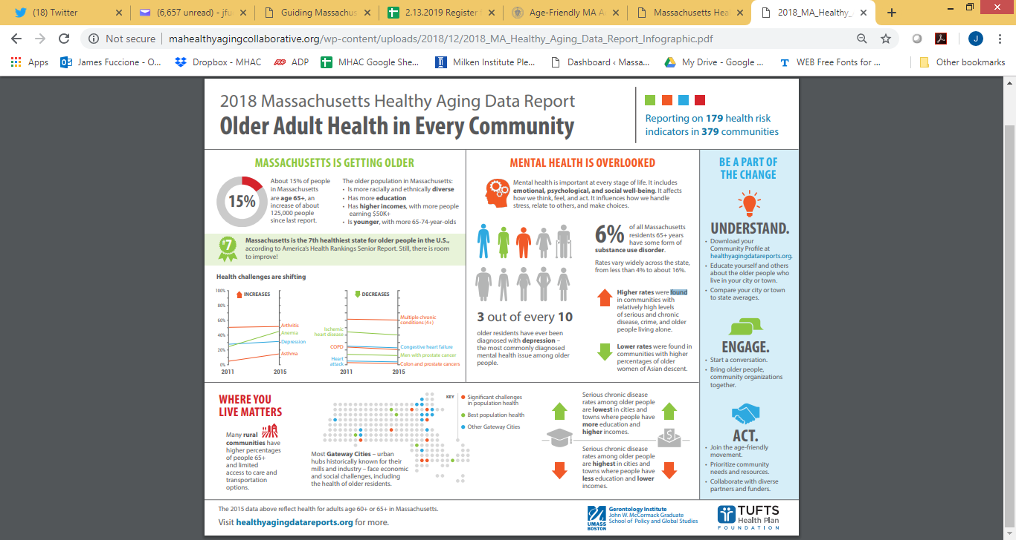
MA Healthy Aging Data Report: Infographic

Slide 13
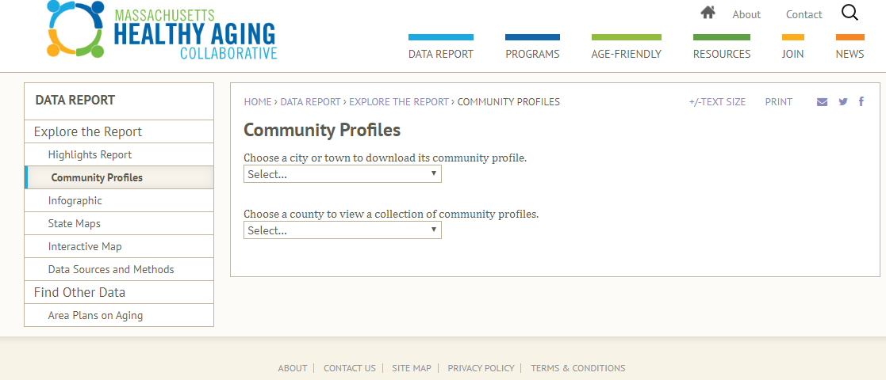
Data: Start the Conversation

Slide 14
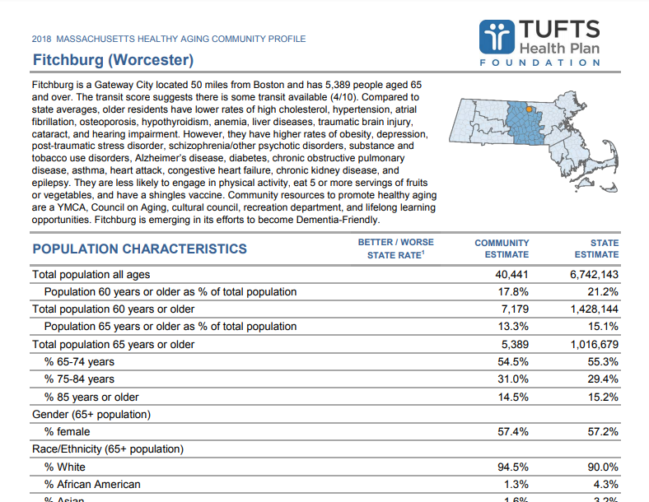
Data: Start the Conversation

Slide 15
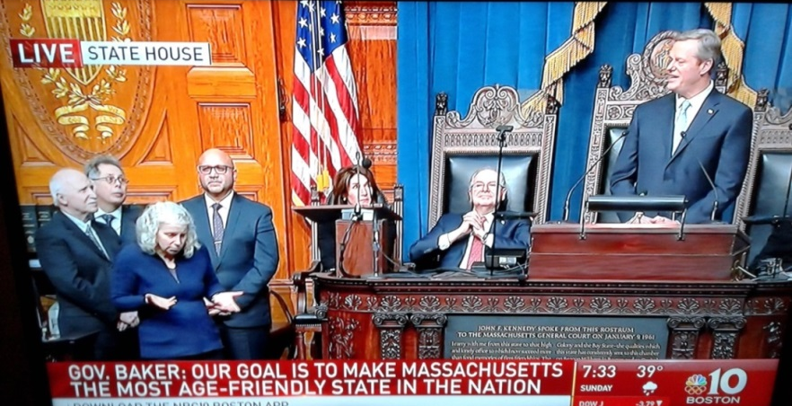
Governor Baker’s Challenge
AF + DF
“We need to think differently about aging in Massachusetts. This isn’t just about acknowledging a shift in demographics; it’s about being intentional in our planning to ensure that those who grew up here, raised families and built communities, can continue to contribute their energy experience and talents where they live and make Massachusetts the most age-friendly state.”
– Governor Charles D. Baker, 2018 –

Slide 16
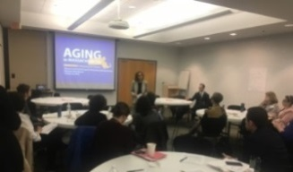
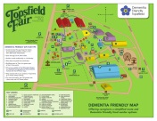

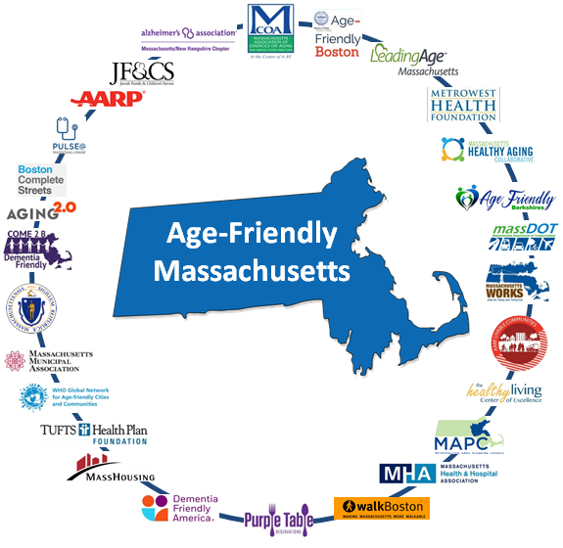
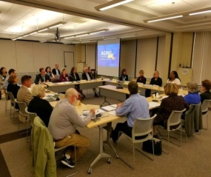


Age-Friendly Massachusetts
Community-Led Age and Dementia Friendly Efforts
Dementia Friendly Massachusetts
Feedback and Input from Stakeholders
Massachusetts Healthy Aging Collaborative
(MHAC and Multicultural Coalition on Aging)
Governor’s Council to Address Aging in Massachusetts
Cross-Sector Partnerships and Collaboration
ReiMAgine Aging:
Planning Together to Create an
Age-Friendly Future for Massachusetts
AF + DF
Input from 500+ Residents Across Massachusetts
State Commissions on Issues Critical to Older People
Sector-Specific
Age-Friendly Initiatives

Slide 17
Age-Friendly Massachusetts
Mission
Goals
To amplify, align, and coordinate local, regional, and statewide efforts to create a welcoming and livable Commonwealth as residents grow up and grow older together.
Deepen Community Initiatives
Promote Information and Communication
Reframe Aging
Embed Aging in Policy and Practice
Improve Economic Security
Create Sustainability
Vision
Aging in Massachusetts is reimagined.
The Commonwealth is an accountable partner in supporting communities, embedding aging in all policies, and empowering residents with opportunities to age meaningfully in the communities of their choice.

Slide 18
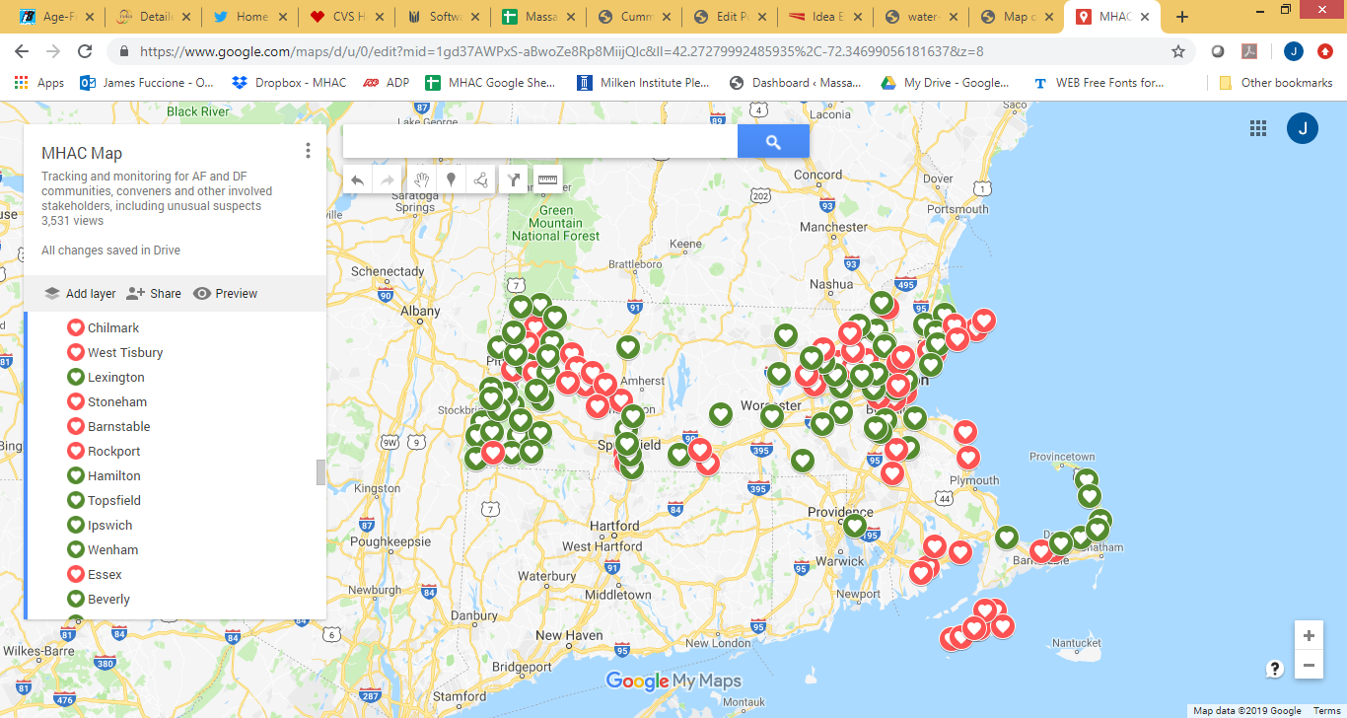
Map of Activity
  63 Active Age-Friendly Designations (AARP/WHO) covering 93 Communities
  65+ Emerging Age-Friendly Communities
AF + DF

Slide 19
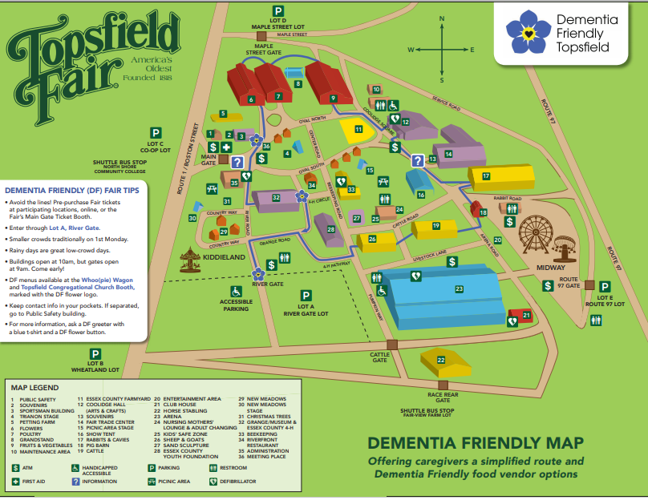
Examples: Dementia Friendly Topsfield Fair

Slide 20
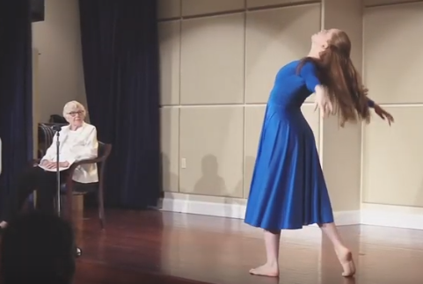
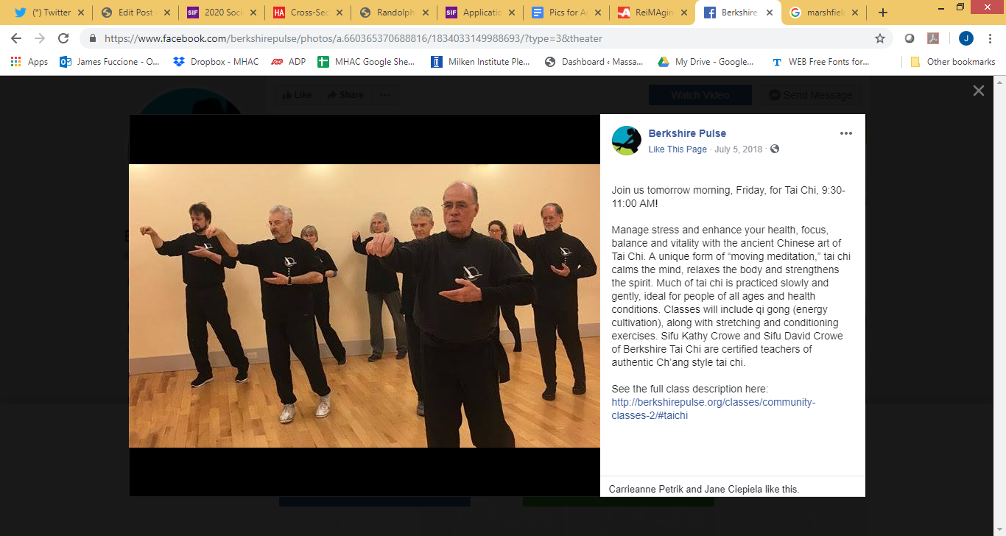
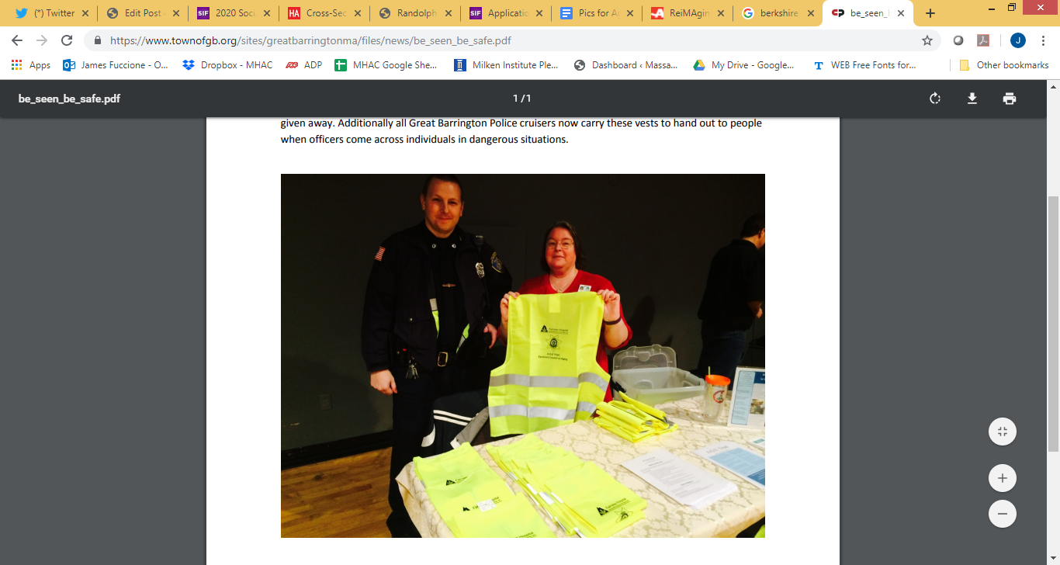
Examples: Age Friendly Berkshires
Berkshire Pulse
NADTC Transit Pilot/”Bee Seen, Be Safe”

Slide 21
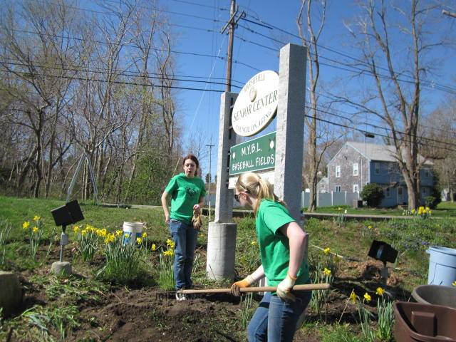

Examples: We Are Marshfield Project
Seventh Annual volunteer project involving high school seniors.
April 2019:
208 students volunteering,
80 parent chaperones
34 teams of students
42 sites around our town

Slide 22

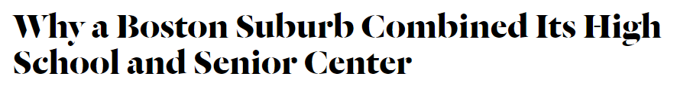
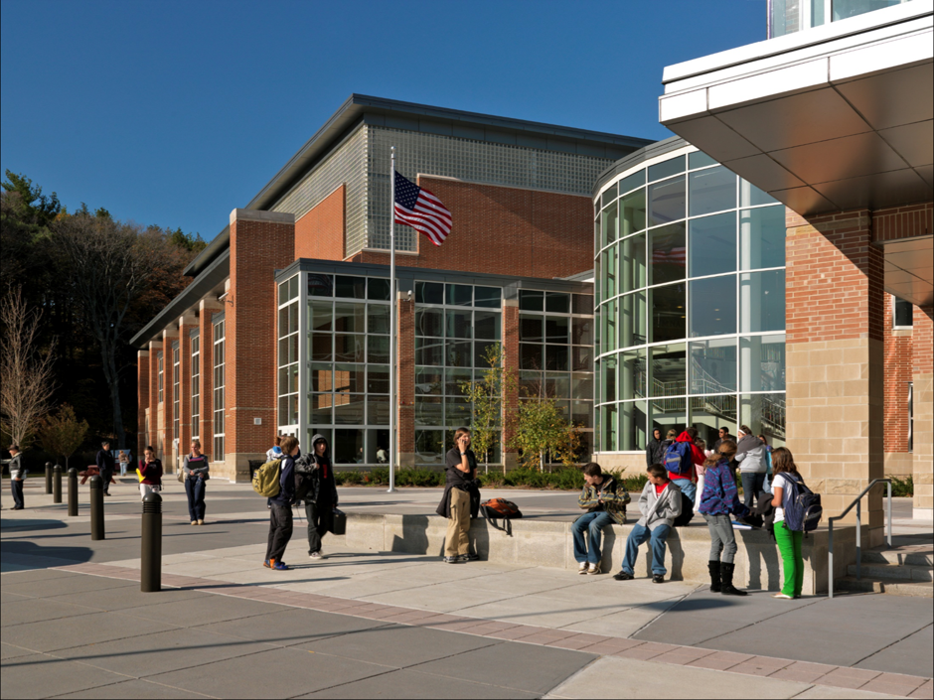
Examples: Swampscott HS, Senior Center

Slide 23
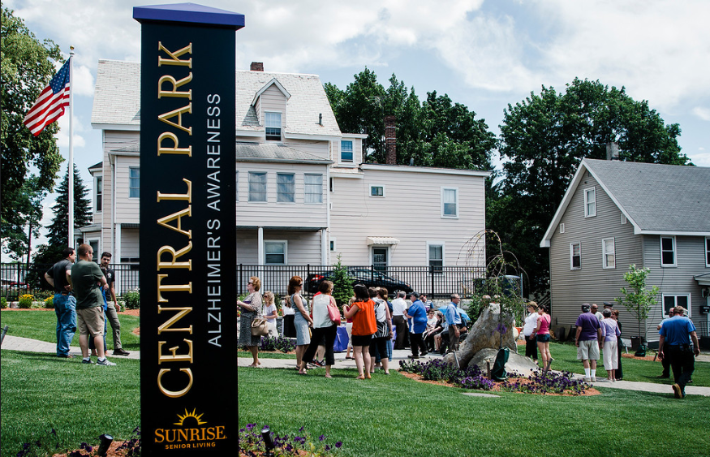
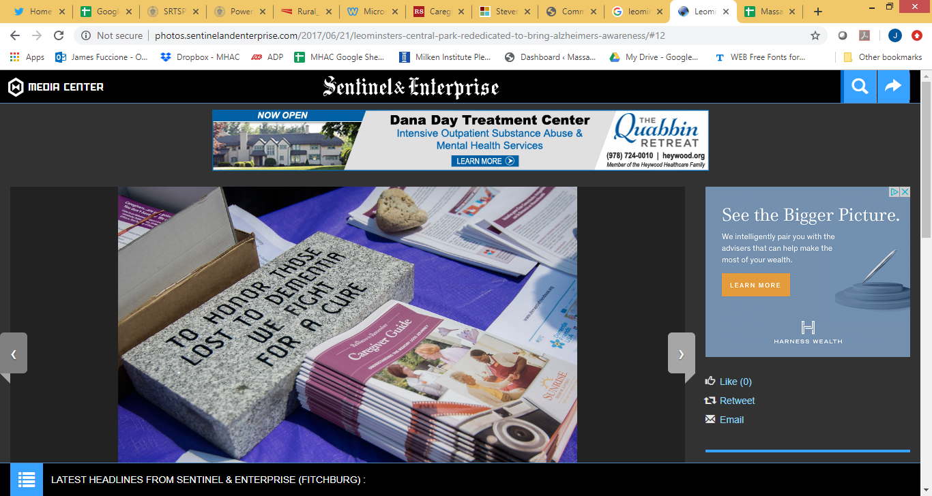
Examples: Leominster Dementia Awareness Park

Slide 24
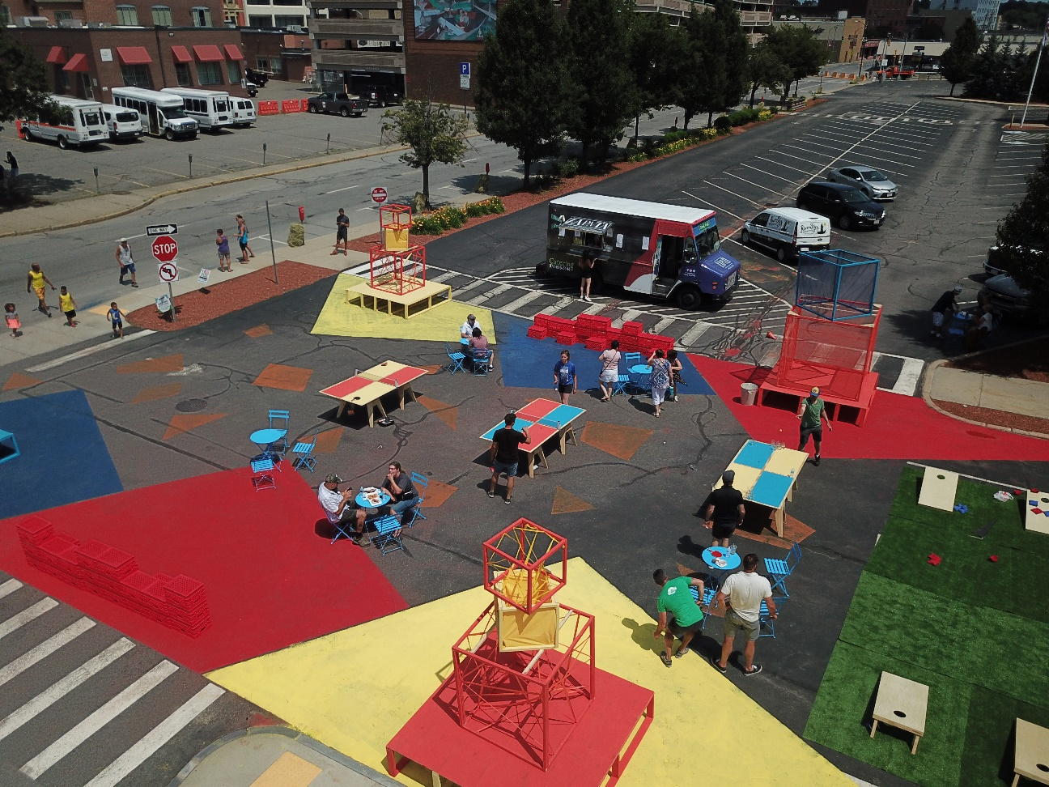
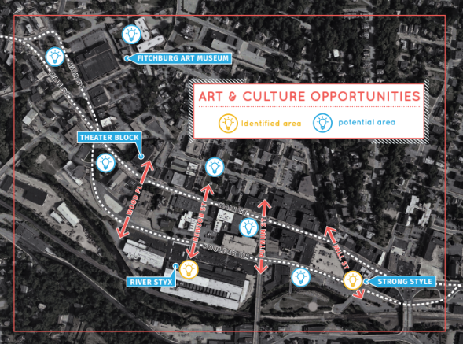

Examples: Fitchburg Placemaking Project

Slide 25

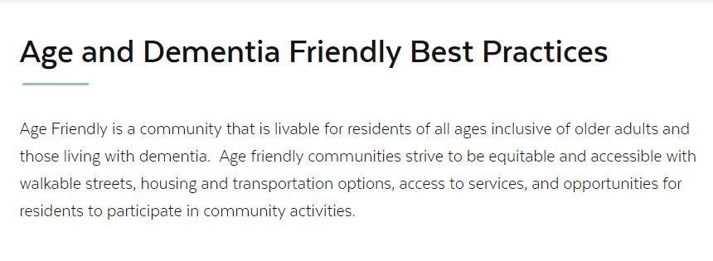
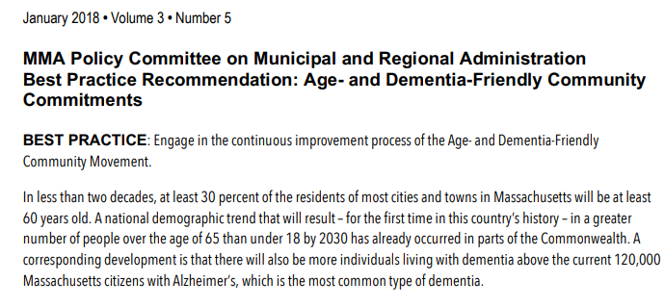
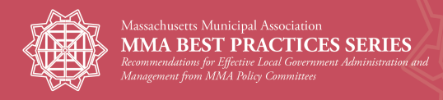
Age- and Dementia Friendly Best Practices

Slide 26
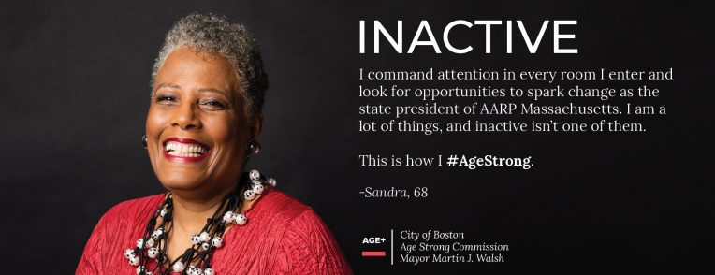
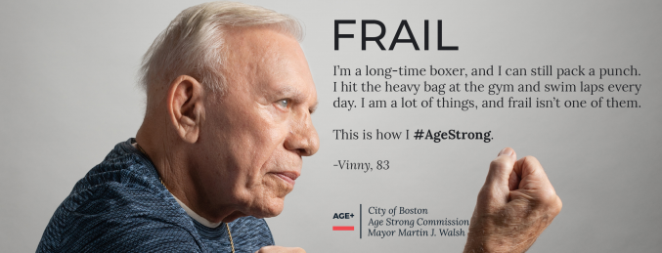
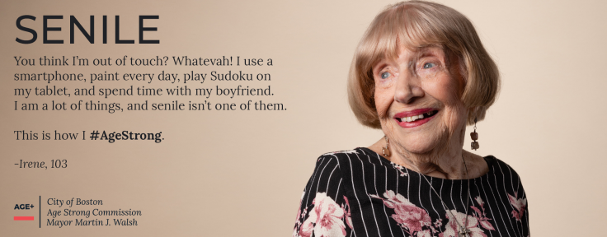
Examples: #AgeStrong

Slide 27
Discussion:
Creating an Age- and Dementia Friendly Region:
At your table:
1
Introduce yourself!
2
Talk about how your work/studies/volunteering supports healthy aging?
3
What are barriers to healthy aging in your community and the region?
4
Is your group interested in co-leading/participating in an Age-and Dementia Friendly initiative?
Who else should be invited to such a group?
5

Slide 28



Thank You!
James Fuccione: James.Fuccione@mahealthyaging.org
  617-717-9493

