Slide 1

Welcome
Massachusetts Healthy Aging Collaborative
Advisory Council Meeting
James Fuccione – Senior Director
Wednesday, August 2, 2017
The work of the Massachusetts Healthy Aging Collaborative is supported in part by Tufts Health Plan Foundation.

Slide 2
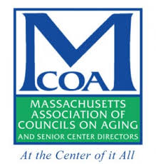




What is the MHAC?
The Massachusetts Healthy Aging Collaborative is a network of leaders in community, health and wellness, government, advocacy, research, business, education, and philanthropy who have come together to advance healthy aging.
Focus: Advancing Age-Friendly and Dementia Friendly Communities
Initiate behavior change among policymakers and planners to use an age-friendly lens and adopt specific asks (aging in all policies).
Create “champions” among the usual and unusual suspects and raise public awareness of healthy aging and age-friendly community efforts.
Build capacity of local communities to embark on the age-friendly designation journey

Slide 3
Timeline: Age-Friendly Movement
AARP becomes USA affiliate for WHO
Dementia Friendly America Announced at WH Conference on Aging
International/National:
WHO Age-Friendly
2005 to Today
Dementia Friendly MA
Tufts HP Foundation and Healthy Aging
Massachusetts:
Mass. Healthy Aging Collaborative: Convener/Steering Committee
Mass. Healthy Aging Collaborative: Action

Slide 4
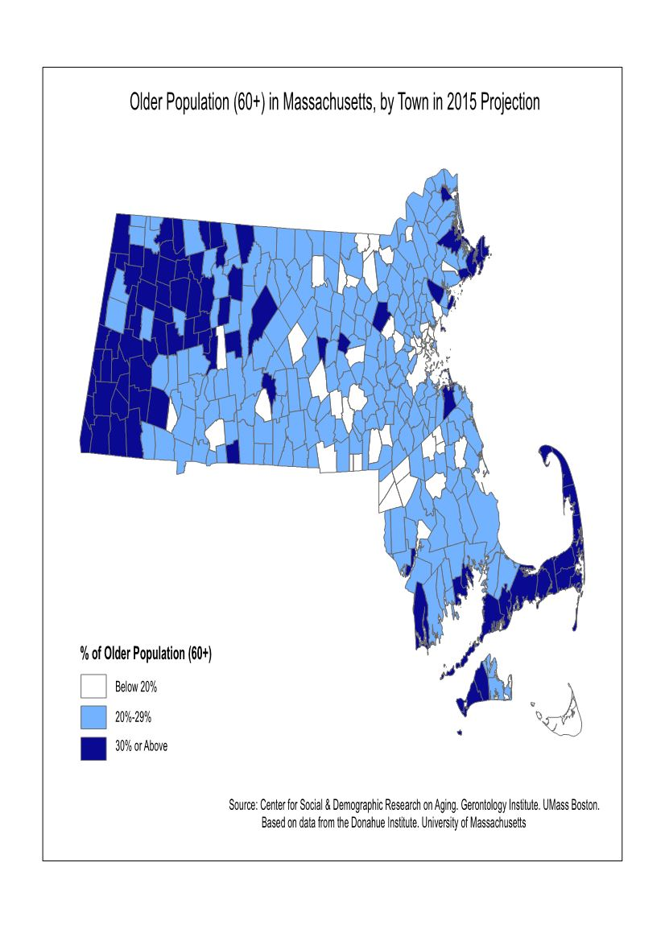
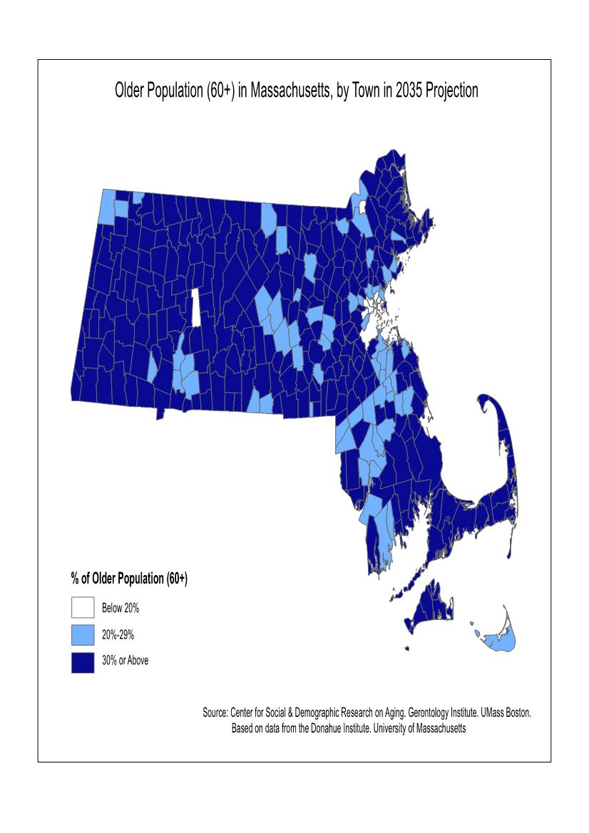
Aging Population in Massachusetts (60+)
Current state
20-year projection

Slide 5
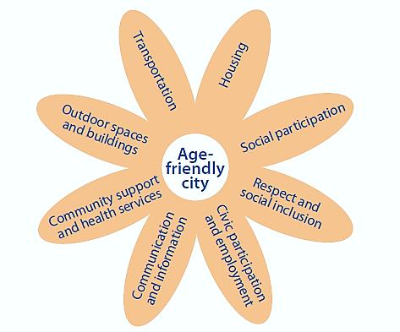
What is “Age-Friendly”?
A continuous improvement process focusing on three areas:
  built environment
  community and health services, and
  inclusion and engagement.
Built Environment
Community and Health Services
Inclusion and Engagement

Slide 6
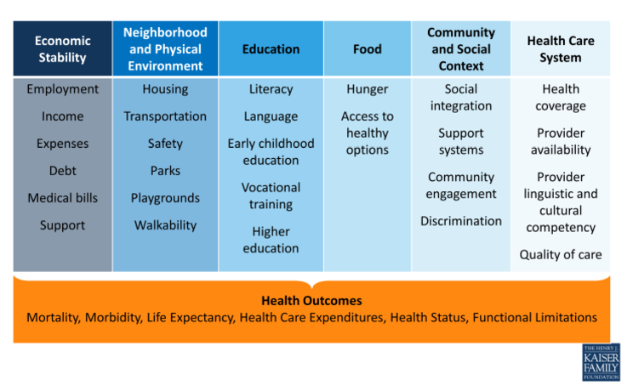
What is “Age-Friendly”?
Focused on linking Social Determinants of Health

Slide 7
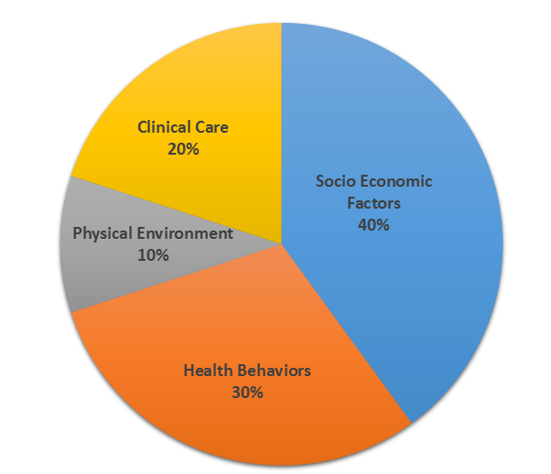
What Determines Health?
Source: Countyhealthrankings.org

Slide 8
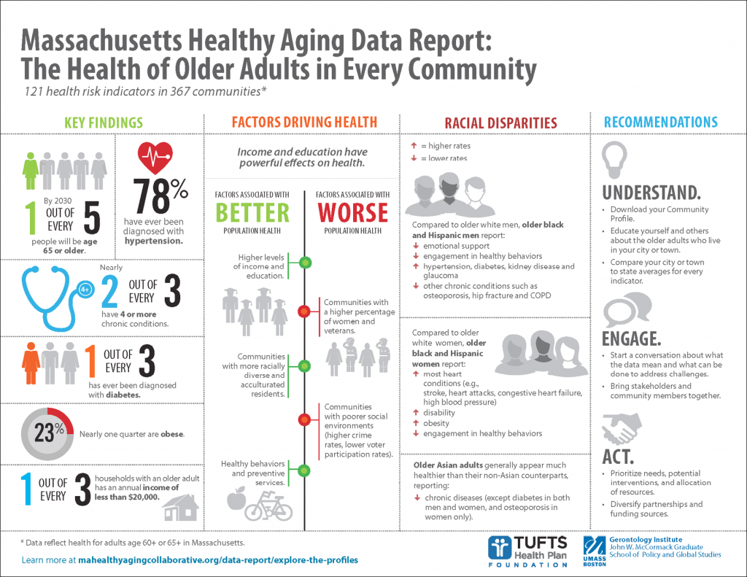

Slide 9
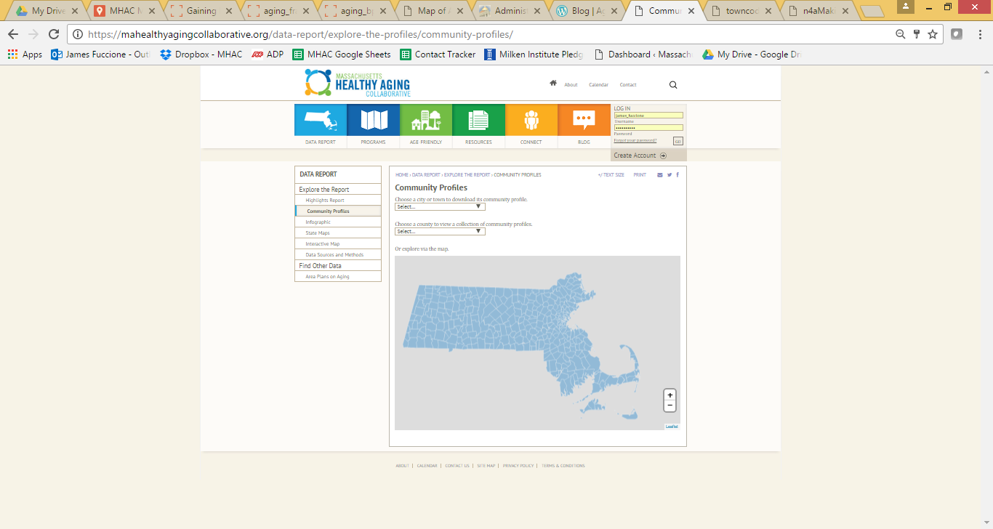

Slide 10
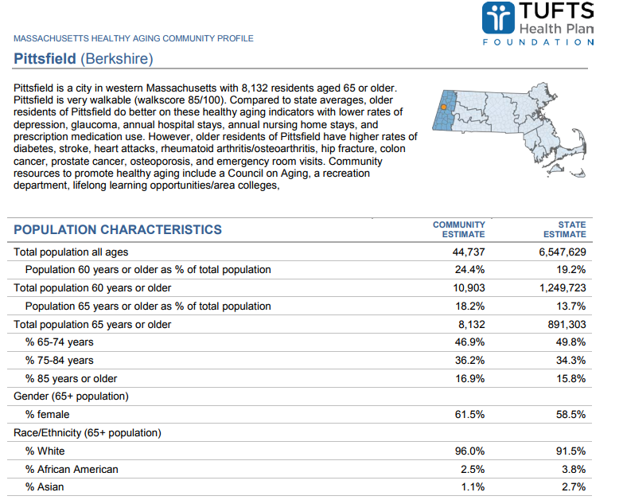

Slide 11
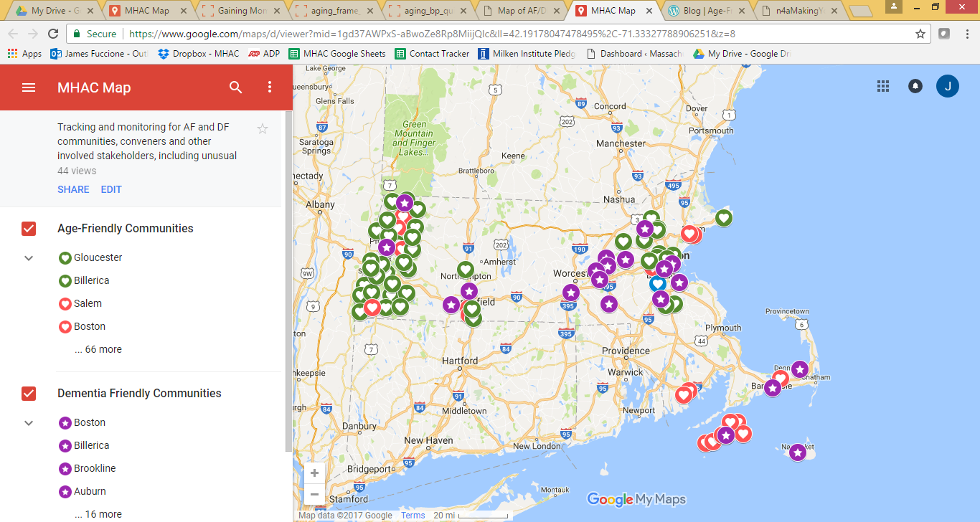
Current State – AF/DF Communities

Slide 12

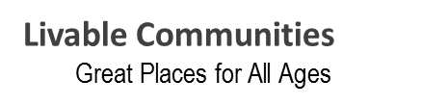
AARP Age-Friendly Resources
Community Challenge Grants This year AARP launched a grant program for “shovel ready” Age Friendly pilots and activities. All communities/organizations were invited. Will continue.
Quarterly Webinars
Annual Conferences
TA with applications and action plans
Online toolkits and sample documents
Private Facebook page for Network members
AARP Livability Index - http://bit.ly/1E1CiZg
Resources are developed as needs and opportunities arise.

Slide 13


Dementia Friendly Massachusetts
GOALS:
Support and accelerate the creation and expansion of dementia friendly systems and grassroots programs across Massachusetts.
Ensure that diverse stakeholders are engaged, and that benefits reach varied geographic and cultural communities.
Support the integration of age-friendly and dementia friendly efforts.

Slide 14
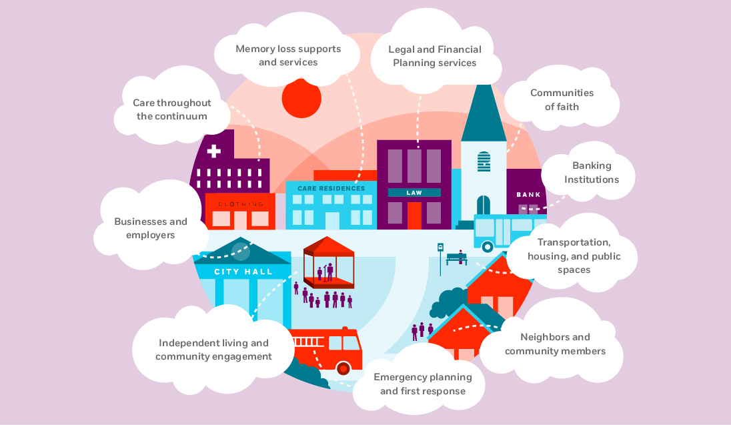
Dementia Friendly Massachusetts

Slide 15
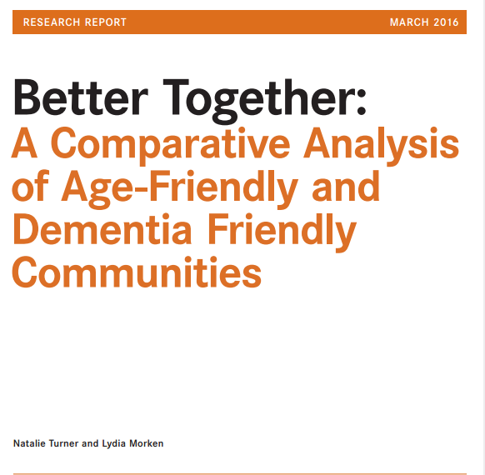
Better Together Strategy

Slide 16
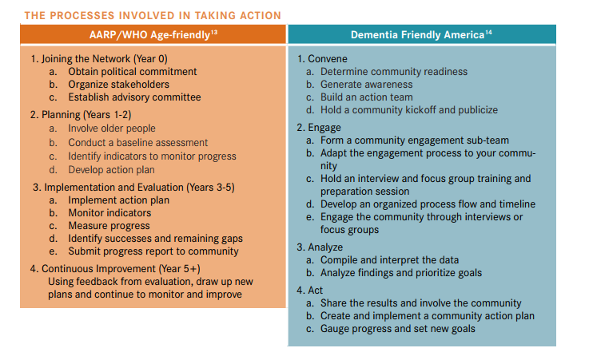
Better Together Strategy

Slide 17
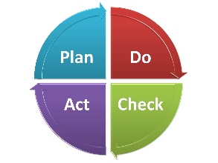




Highlights and Updates
Action Plans from Boston, Age-Friendly Berkshires
Presented at MA Smart Growth Alliance, HLCE “Sharpening Your Skills,” LeadingAge MA, Mass Municipal Association
$1.7m in THPF funding to age/dementia friendly causes/communities, AARP Community Challenge
Met with representatives from 22 cities and towns, Age-Friendly RI
Convened three MHAC Strategy Subcommittees and plan to add a fourth on Access, Equity and Cultural Inclusion

Slide 18
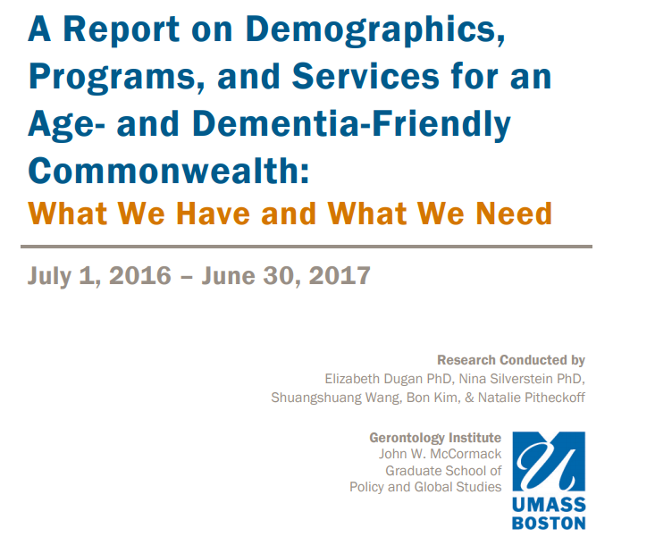

Slide 19
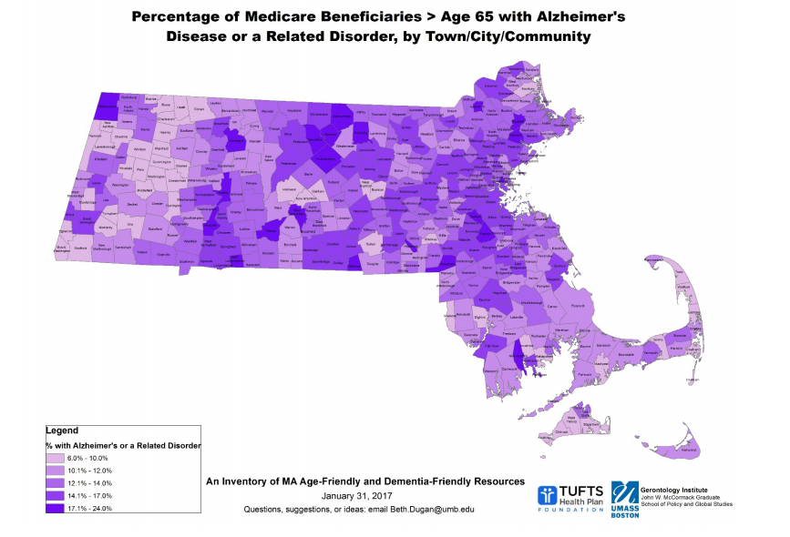

Slide 20

Discussion
Public comments to Governor’s Council
Assistance and support from MHAC, AARP, DFMA

Slide 21
Resources and Contact Info
James Fuccione: James.Fuccione@mahealthyaging.org
  617-717-9493
AARP: Livability Index
Dementia Friendly Massachusetts Toolkit
MHAC: Age-Friendly Toolkits
MHAC: Mass. Healthy Aging Community Profiles
MHAC: Current Age/Dementia Friendly Communities in MA
N4A Report: Making Your Community Livable for All Ages
WHO: Checklist of essential features of age-friendly cities
NEW! “What We Have and What We Need” – Building an Age- and Dementia Friendly Commonwealth

